Slide 1
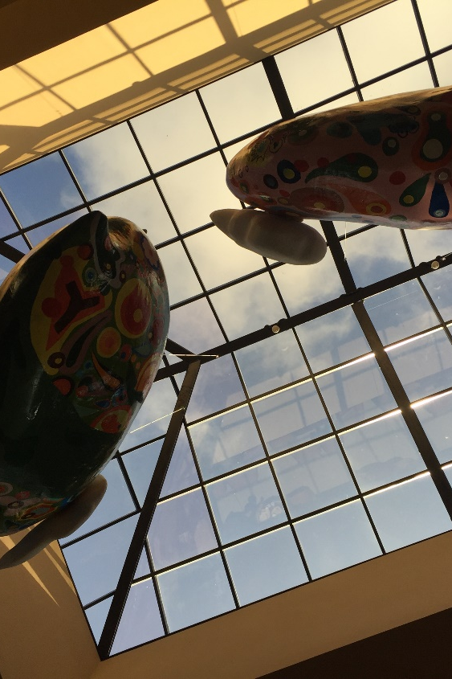

ELEPHANT FX
中文/Eng
The most beautiful and easy-to-use Currency Exchange
Reliable - 100% approved by the China’s SAFE.
Secure - Order online and trade in stores.
Economical – The most optimal exchange rates with 0 handling charge.
Convenient – The network Cover 25 airports, 32 transportation junction, and 12 entry-and-exit ports in the majority of Chinese big cities.
Time-saving - Ordering online and pick it up immediately and conveniently wherever you start your journey.
Worry-saving – The fixed exchange rates after placing oder
Brown Café, Yilan
SHANGHAI MAIJU INFO TECHNOLOGY CO., LTD
5F, Standard Chartered Bank Building, 201 Century Avenue, Lujiazui, Shanghai
Customer Services: QQ 1582837075 | Hotline +86 21 61826879 | Email CS@fxswap.cn‍
Business Cooperation: Biz@fxswap.cn | Wechat: Daxiang_FX
Copyright © 2016 大象汇率（www.fxswap.cn）, All Rights Reserved

